Slide 1
Unit 8 Association
Machine Learning
https://www.javatpoint.com/association-rule-learning

Slide 2
Association Rule Learning (1/2)
Association rule learning is a type of unsupervised learning technique that checks for the dependency of one data item on another data item and maps accordingly so that it can be more profitable.
It tries to find some interesting relations or associations among the variables of dataset.
Association Rule learning is a rule based machine learning method which is used to discover interesting relationships hidden in large datasets.

Slide 3
Association Rule Learning (2/2)
It is based on different rules to discover the interesting relations between variables in the database.
it is employed in Market Basket analysis, Web usage mining, continuous production, etc.

Slide 4
Market Basket Analysis (1/2)
Market basket analysis is a technique used by the various big retailer to discover the associations between items.
As in a supermarket, all products that are purchased together are put together.

Slide 5
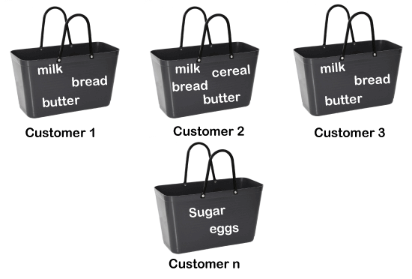
Market Basket Analysis (2/2)
For example, if a customer buys bread, he most likely can also buy butter, eggs, or milk, so these products are stored within a shelf or mostly nearby.

Slide 6

How does Association Rule Learning work? (1/2)
Association rule learning works on the concept of If and Else Statement, such as if A then B.
The If element is called antecedent (A), and then statement is called as consequent (B).

Slide 7
How does Association Rule Learning work? (2/2)
These types of relationships where we can find out some association or relation between two items is known as single cardinality.
It is all about creating rules, and if the number of items increases, then cardinality also increases accordingly.
So, to measure the associations between thousands of data items, there are several metrics.
  Support, Confidence and Lift

Slide 8

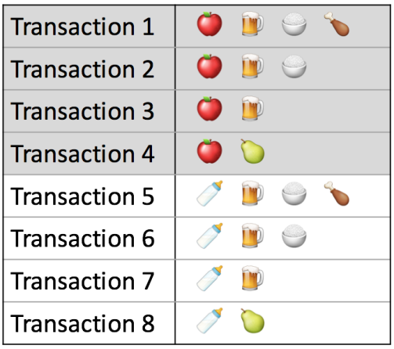


Association metrics
To measure the associations between thounsands of data items, there are several metrics:
Notes:
Support and confidence is calculated to overcome the issue where some patterns in data can occur by chance.Support is an important measure because a rule that has very low support may occur simply by chance. Moreover a low support rule is also less interesting for business perspective also because it may not be profitable to promote items which customers seldom buy together.For a rule {A} →{B} with high confidence indicates that B is more likely to occur with A. For rule {A} →{B}
By calculating support we know whether the rule is significant.
By calculating confidence, we come to know how likely A and B will occur together.

Slide 9
Support
Support is the frequency of A or how frequently an item appears in the dataset. It is defined as the fraction of the transaction T that contains the itemset X.
If there are X datasets, then for transactions T, it can be written as:

Slide 10
Confidence
Confidence indicates how often the rule has been found to be true.
Or how often the items X and Y occur together in the dataset when the occurrence of X is already given.
It is the ratio of the transaction that contains X and Y to the number of records that contain X.

Slide 11
Lift (1/2)
It is the strength of any rule, which can be defined as below formula:
It is the ratio of the observed support measure and expected support if X and Y are independent of each other.

Slide 12
Lift (2/2)
It has three possible values:
  If Lift= 1: The probability of occurrence of antecedent and consequent is independent of each other.
  Lift>1: It determines the degree to which the two itemsets are dependent to each other.
  Lift<1: It tells us that one item is a substitute for other items, which means one item has a negative effect on another.

Slide 13
Types of Association Rule Learning
Association rule learning can be divided into three algorithms:
  Apriori Algorithm
  Eclat Algorithm
  F-P Growth Algorithm

Slide 14
Apriori Algorithm (1/2)
This algorithm uses frequent datasets to generate association rules.
It is designed to work on the databases that contain transactions.
This algorithm uses a breadth-first search and Hash Tree to calculate the itemset efficiently.

Slide 15
Apriori Algorithm (2/2)
It is mainly used for market basket analysis and helps to understand the products that can be bought together.
It can also be used in the healthcare field to find drug reactions for patients.

Slide 16
Eclat Algorithm
Eclat algorithm stands for Equivalence Class Transformation.
This algorithm uses a depth-first search technique to find frequent itemsets in a transaction database.
It performs faster execution than Apriori Algorithm.

Slide 17
F-P Growth Algorithm
The F-P growth algorithm stands for Frequent Pattern, and it is the improved version of the Apriori Algorithm.
It represents the database in the form of a tree structure that is known as a frequent pattern or tree.
The purpose of this frequent tree is to extract the most frequent patterns.

Slide 18
Applications of Association Rule Learning
It has various popular applications in machine learning and data mining.
  Market Basket Analysis: This technique is commonly used by big retailers to determine the association between items.
  Medical Diagnosis: With the help of association rules, patients can be cured easily, as it helps in identifying the probability of illness for a particular disease.

Slide 19
Applications of Association Rule Learning
Protein Sequence: The association rules help in determining the synthesis of artificial Proteins.
It is also used for the Catalog Design and Loss-leader Analysis and many more other applications.

Slide 20
Algorithm?
Dataset ?
Dummies?
Info()?
Bool # 01?
Performance metric?

